Slide 1
Stroke and Health Status
Sagar Bansal, Haochen Jiang, Liuqing Wang, Snow Wang
Notes:
Hello, we are Team 4.0. I am Haochen, My teammates are Sagar, Liuqing, and Snow.

Slide 2

Agenda
Introduction
Data Characteristics
Supervised Learning
Logistics Regression
Unsupervised Learning
Cluster Analysis
Discoveries & Limitations
Notes:
Our topic is stroke and health status, here is our agenda.
We have introduction, data characteristics, and supervised learning technique with logistic regression model. Unsupervised learning technique with cluster analysis. Then the discoveries and limitations.

Slide 3
Introduction

Slide 4
Introduction
Motivation of Analysis
Stroke
Blood vessel blockage causes insufficiency of blood supply to the brain
5th cause of death and leading cause of disability in the U.S.
140,000 deaths per year, 40 patients per second
Project Goals
Examine relationships
Perform inferential statements
Interpretation
Find relationships between observations
Notes:
Firstly, I would like to introduce some basic information about stroke. Stroke is cerebrovascular diseases, occurs when there is not enough blood flowing to the brains and blockage of arteries to the brains. It usually happens suddenly and can cause high mortality and disability. According to the CDC, stroke causes more than 140,000 (140 thousand) death each year and 40 people are getting stroke per second and ranks as the fifth cause of death in the United States. Our team is determined to take a deeper look at this disease.
In this project, We will examine the underlying relationship or structures between whether people had strokes or not and 6 variables. Then, we will interpret the relationships and perform inferential statements about the importance of these variables. Additionally, we would like to find relationships between observations and see if we can identify meaning groups for the observations.
Next Snow will talk about our data characteristics

Slide 5
Data Characteristics
Notes:
Next Snow will talk about our data characteristics

Slide 6
Data Description
Original dataset
Observational & cross-sectional
12 variables with 43400 observations
Dataset after cleaning
7 variables were chosen based on our primary interest
29072 observations
Stroke
Hypertension
Heart Disease
Smoking Status
Age
Average Glucose Level
Body Mass Index
Notes:
Thank you haochen
We found the dataset on Kaggle.com and the original dataset was published by Mckinsey & Company for one of their case studies. Our dataset is observational and cross sectional.
There are 12 variables with 43400 observations in the original dataset.
Because The primary interest of this project is to find the relationships between pre-existing health conditions and stroke, only 7 out of the 12 variables from the original dataset were chosen. And After cleaning out observations with null values, we have a total of 29072 observations to study with.
Our response variable is whether or not the person has had a stroke experience
Our three qualitative predictors are heart disease, smoking status, and hypertension, which is abnormally high blood pressure
Our three quantitative variables include age, average glucose level, and body mass index which is used to determine body fatness.

Slide 7
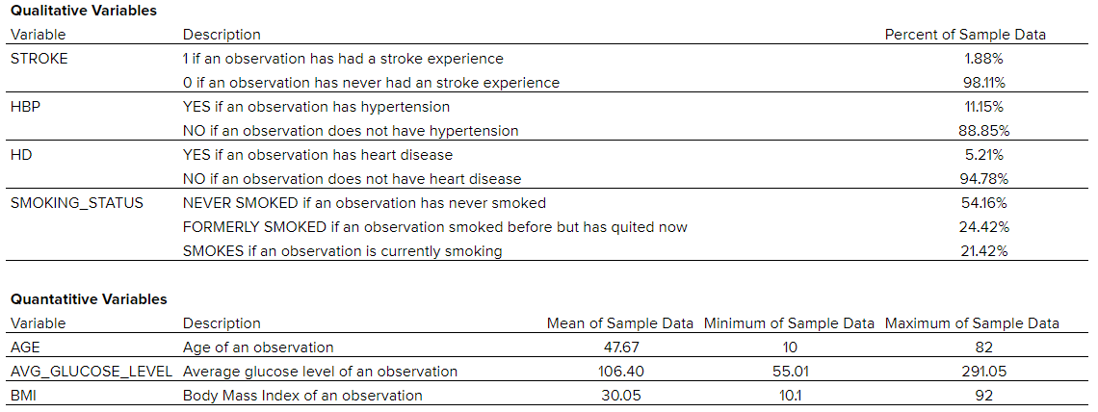
Basic statistics
Observed an imbalance issue but it is an accurate description of reality
Notes:
Here’s a general look of our dataset including the percentages of each category for our qualitative variables and the average and range of our quantitative variables.
Stroke, our response, is a dummy variable where 1 means the person has had a stroke and 0 means the person has not had a stroke. Within all the observations, only 1.88% of the sample size have had stroke experiences, and therefore an imbalance issue was observed. However, we believe the imbalance is a true representation of the population considering there’s only a very small amount of people in the world who are bothered with this disease.
Overall, our dataset covers a great range of people where the age range is from 10 year old to 82 year old with a mean of 48 year old.

Slide 8
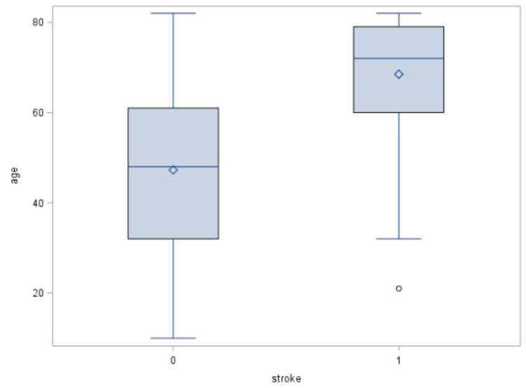
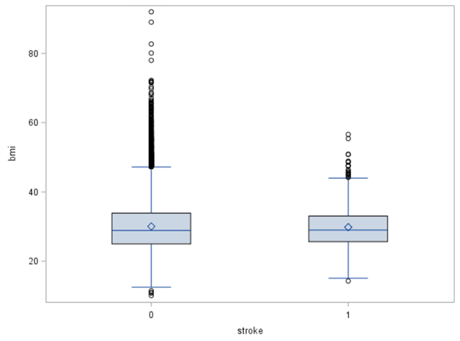
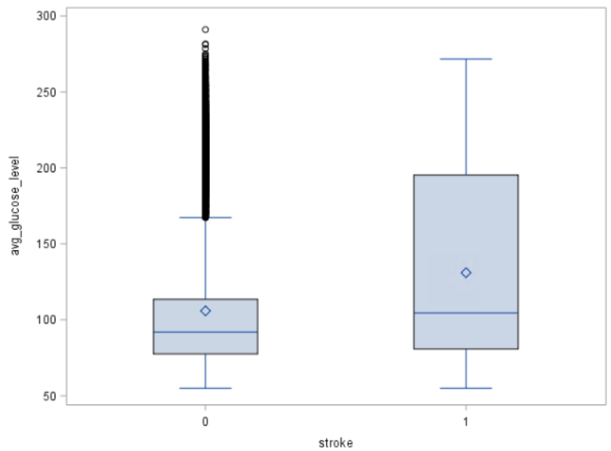
Initial Observations
Average Glucose Level
Age
bmi
Notes:
And here are findings during our initial investigation
we can see from the figure on the very left, that people who had strokes have a older age distribution than people who never had strokes and therefore we believe there’s relationship between age and stroke where older people tend to have strokes.
From the figure in the middle, we see that people who had strokes have a wider and higher average glucose distribution than people who never had strokes and therefore we believe average glucose level is associated stroke where people with higher glucose level tend to have strokes.
We did not observed any relationship between bmi and stroke.

Slide 9
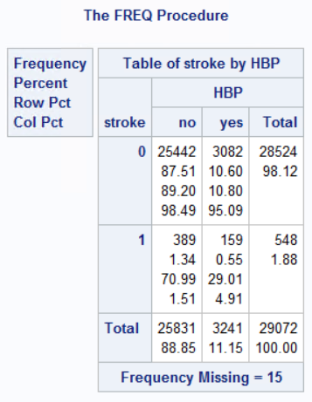
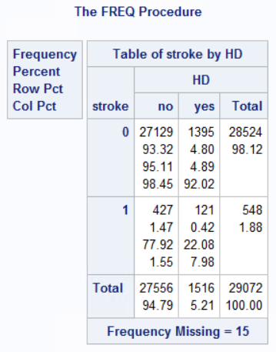
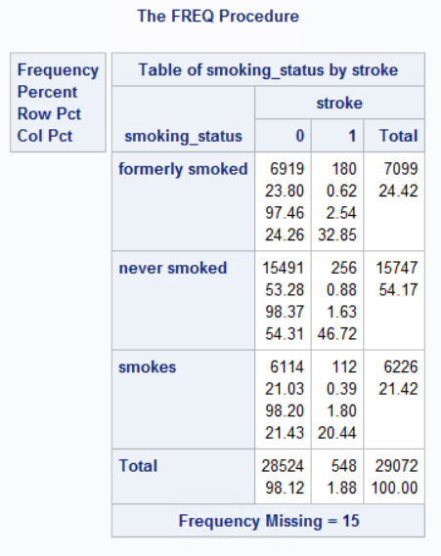
Initial Investigation
Notes:
From the chart on the left, we see that only 1.51% of people who doesn’t have hypertension had a stroke, whereas 4.91% of people who have hypertension had a stroke.
As shown in chart in the middle, we see that only 1.55% of people who doesn’t have heart disease had a stroke, whereas 7.98% of people who have heart disease had a stroke.
Therefore, we believe there might be some underlying relationships between hypertension and stroke experience, as well as heart disease and stroke experience.
We did not see any relationships between smoking status and stroke.

Slide 10
Supervised Learning
- Logistic Regression
Notes:
Next, Joyce will lead us through our supervised learning analysis

Slide 11
Model Selection
Logistic Regression Model
6 Predictors
3 qualitative variables
Hypertension, heart disease, smoking status
3 quantitative variables
Age, average glucose level, bmi (body mass index)
Response
Whether people had strokes or not
Notes:
For the supervised learning, we chose the logistic regression model.
We included 3 qualitative and 3 quantitative variables in the model. As snow already mentioned.

Slide 12
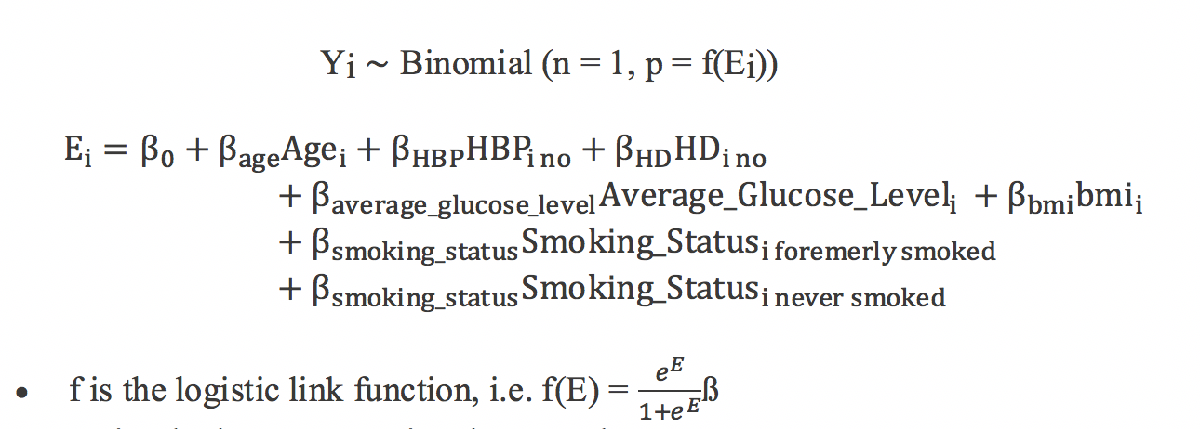
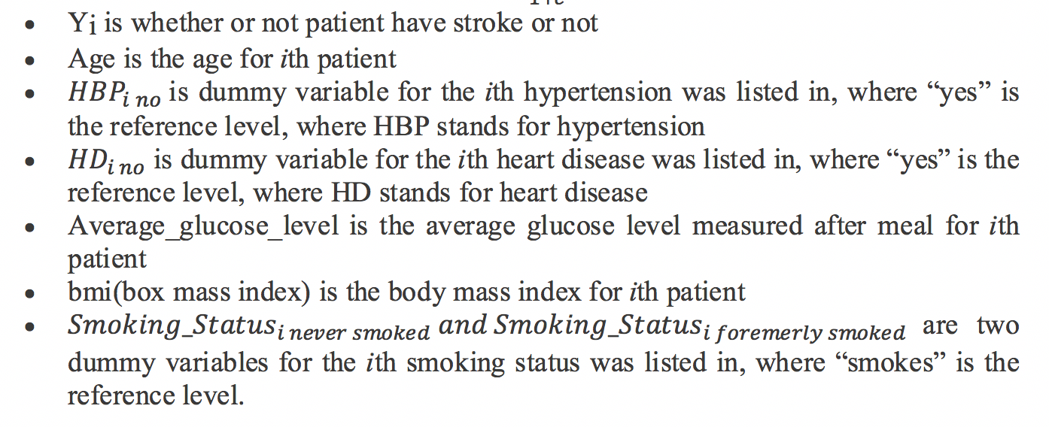
Logistic Regression Model and Assumptions
·
Notes:
This is our model and its assumptions, as you can see it covers all our variables

Slide 13
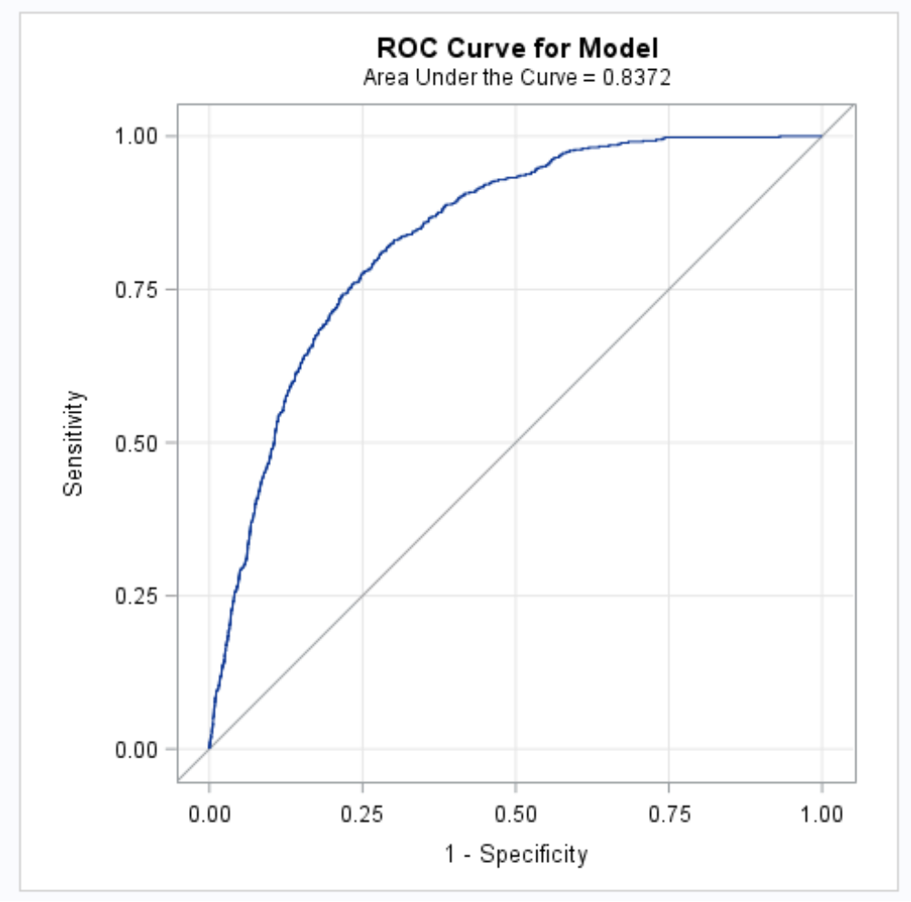
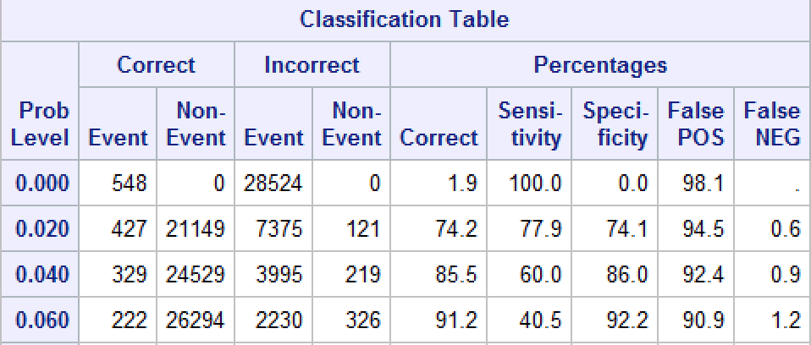
Check Model Utility
Misclassification Rate
25.8%
Optimal % correct:
74.2% when cutoff is 0.02
ROC always above the diagonal line
AUC=0.8372 > 0.5
The model generally performs well
Notes:
When fitting the model and estimating coefficients, we used maximum likelihood estimation. In order to check how useful the model is, by looking at the Classification Table we see that the optimal correct % the model generated is 74.2% when the cutoff is 0.02, which is good but not that great. And the corresponding sensitivity and specificity values are 77.9% and 74.1% respectively.
Next, we can see the ROC curve is always above the diagonal line and AUC is roughly 0.8372 which is greater than 0.5.
So, we can conclude that the model is overall useful.

Slide 14
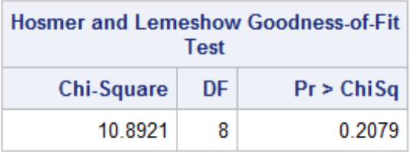
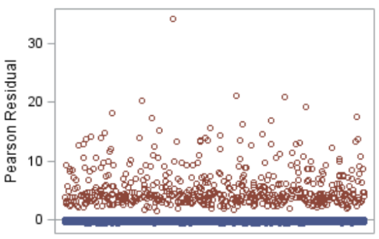
Check Model Validity
“Goodness” of Fit
Hosmer and Lemeshow Test (HL Test)
0.2079 > 0.05
No evidence that the model doesn’t fit well.
Independence Issue
No time series structures
Residual vs. Index plot
No clear patterns
Notes:
In order to evaluate the model’s validity, first we checked the goodness of fit test by using HL test. Assuming at 5% significance level, since P value is 0.2079, larger than 0.05, we fail to reject the null hypothesis, which is the logistic model accurately describes the data. We can conclude there is no lack of fit and there is no evidence that the model doesn’t fit well.
In addition, there is no time series structure in our data set, we can still double check our residual vs. index plot. From the graph, we confirmed that there are no clear patterns in the residuals

Slide 15
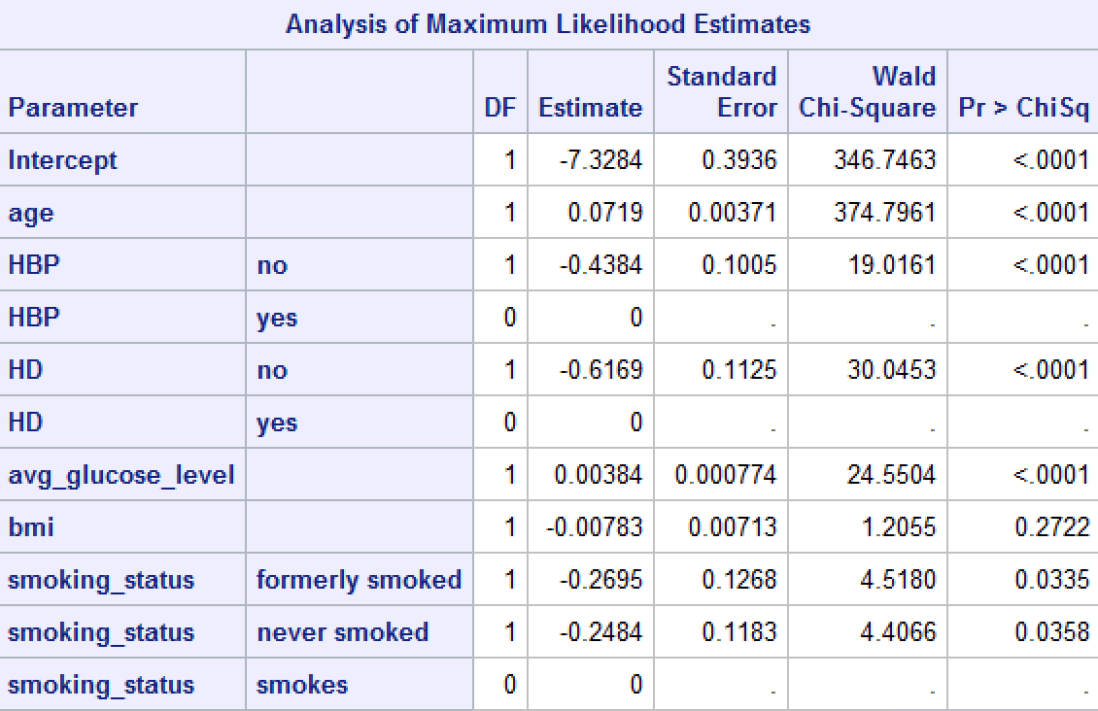
Model Interpretation
Only bmi is not statistically significant
Notes:
Just to save some time, I will not go over every interpretation; but here are some significant ones:
Based on p-values, we found only bmi is not statistically significant. This result confirms our initial observations and provides evidence that BMI will not add much to the odds of having a stroke.

Slide 16

Model Interpretation
Age (quantitative)
An increase in age of 1 year is associated with 7.5% increase in the odds of having a stroke when other variables stay fixed.
Average glucose level (quantitative)
1 unit increase in average glucose level is associated with 0.4% increase in the odds of having a stroke when other variables stay fixed.
Heart disease (qualitative)
People with no heart disease have 46% lower odds of having a stroke than people with heart disease when other variables stay fixed.
Hypertension (qualitative)
People with no hypertension have 35.5% lower odds of having a stroke than people with hypertension, when other variables stay fixed.
Smoking status (qualitative)
People who formerly smoked or never smoked have at least 20% lower odds of having a stroke than people who smoke when other variables stay fixed.
Notes:
For heart disease, it has one of the largest impacts on the odds of having a stroke, as the model estimates that people with no heart disease have about 46% lower odds of having a stroke than people with heart disease when other variables are fixed.
For smoking status, The model estimates that People who formerly smoked or never smoked have at least 22% lower odds of having a stroke than people who smoke when other variables are fixed. 22% for never smoked 23.6% or formerly smoked to be exact.
a. This is an important discovery, because it tells us the impact of formerly smoking on the response is almost similar to never smoking when compared with smoking according to the model.

Slide 17
Model Interpretation Cont.
People who are older, have hypertension, heart disease, higher average glucose level tend to have higher odds of having a stroke for the same other conditions
Impact of formerly smoking on the response is almost the same as never smoked when other variables remain fixed
Notes:
In other words, people who are older, have hypertension, heart disease, higher average glucose level tend to have higher odds of having a stroke for the same other conditions, which aligns with our initial observation as Snow talked about.
The impact of formerly smoking on the response is almost the same as never smoked when compared with smoking according to the model, when other variables remain fixed.

Slide 18
Unsupervised Learning
- Cluster Analysis

Slide 19
Model Selection
Cluster Analysis technique
Variables used to make clusters
Age, average glucose level, bmi (body mass index)
Linkage Criterion
Average Linkage
Method
Agglomerative Hierarchical Clustering
Validation Variable
Whether people had strokes or not
Notes:
Thank you, Joyce! We conducted a hierarchical cluster analysis with average linkage criterion to identify different groups of people using Age, average glucose level and BMI for our unsupervised learning component, We then used Stroke variable to validate our groups.

Slide 20
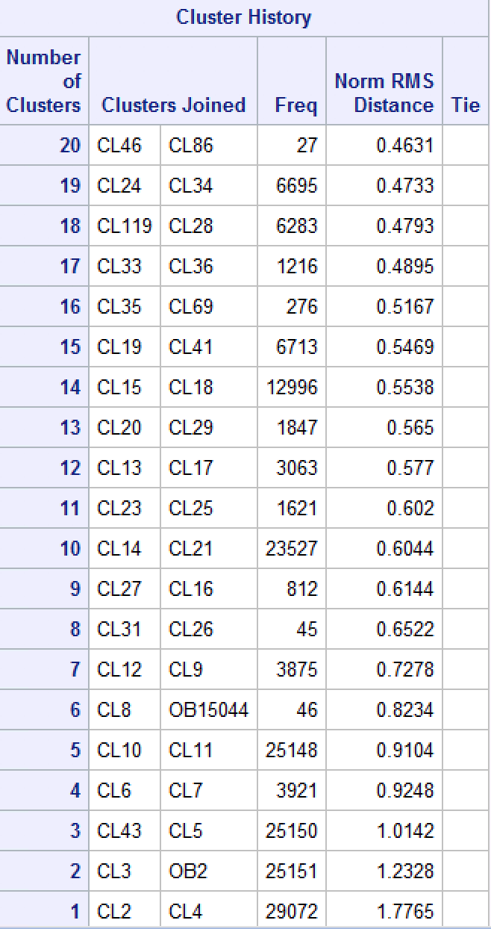
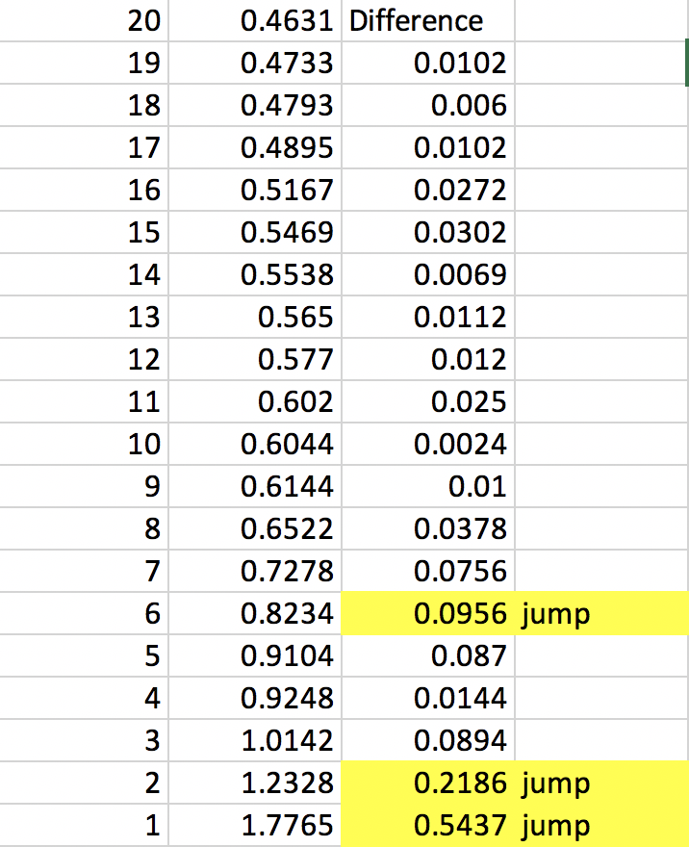
Identifying Jumps
Calculated Difference
Between each cluster
Notes:
Our first step after running the cluster analysis was to identify jumps. Since our dataset had about 30,000 observations, we used the cluster history table and calculated first three biggest differences to recognize clear jumps, which are from 7 to 6, 3 to 2, and 2 to 1.
Hence, we identified three candidate clusterings that have 7, 3, and 2 clusters.
In the output, we have listed last 10 cluster configurations.

Slide 21
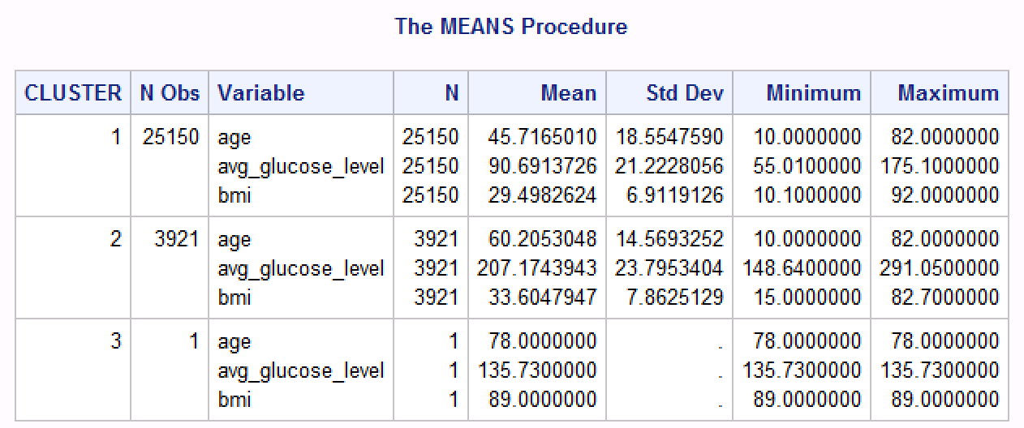
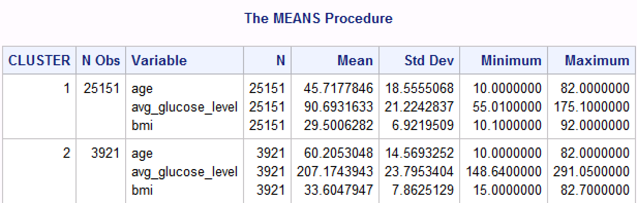
Finding the best Cluster Configuration
The 3-cluster and 2-cluster configurations are almost the same
Not satisfied with using these as our final configuration
Clusters 1 and 2 in both cluster configurations have a wide range of values for several variables
7 cluster configuration seems to be most reasonable
More specific clusters with narrower value ranges
Notes:
In order to find the best cluster configuration, we intended to label these candidate clusterings.
We see that the 3-cluster and 2-cluster configurations are similar except that the third cluster in the first clustering consists of single value which is essentially an outlier.
Also, the individual clusters have very wide range of values for each variable. Therefore, 7-cluster configuration seemed to be most satisfying among all of them as it had more specific clusters with narrower value ranges.

Slide 22
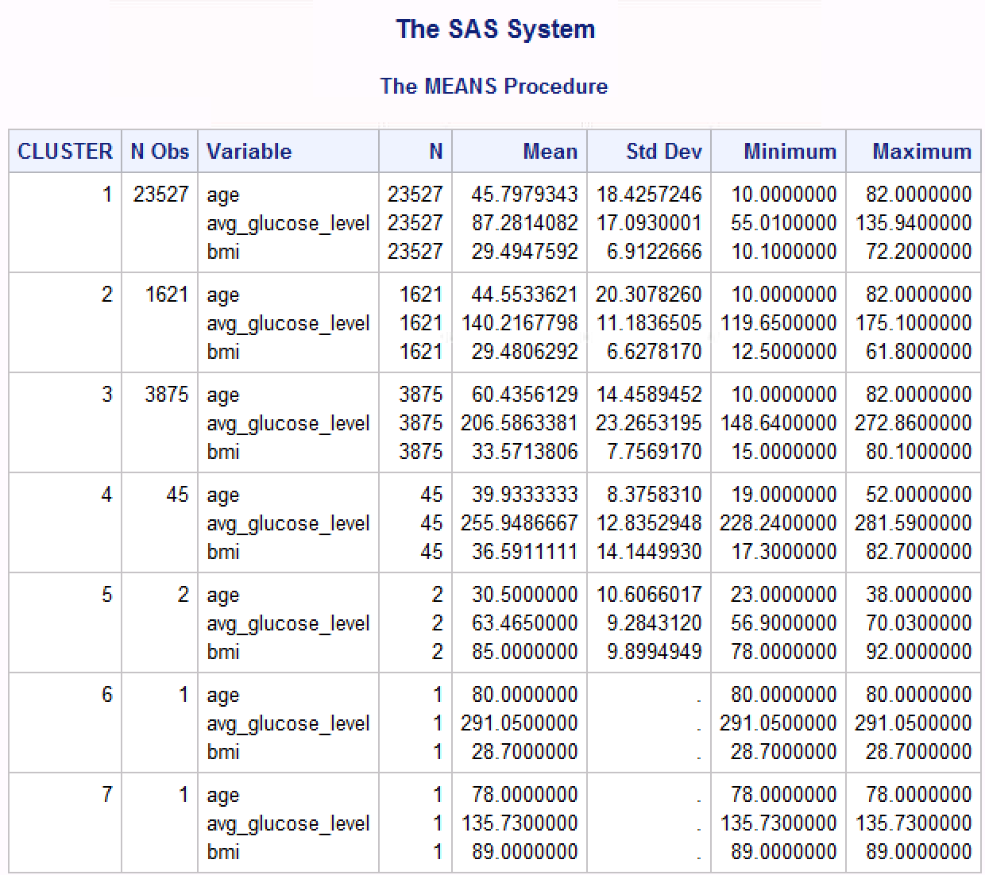
Initial Observations
2 age groups
younger people (10-50 years old)
older people (51-82 years old)
Cluster 1: younger people with slightly low average glucose level and overweight bmi
Cluster 2: younger people with medium average glucose level and overweight bmi
Cluster 3: older people with high average glucose level and obese bmi.
Cluster 4: younger people with very high average glucose level and obese bmi
Cluster 5, 6 and 7: Outliers
Notes:
To better understand the different types of clusters in the 7 cluster configuration, we assumed Age has two groups including younger people from 10 to 50 years old and older people from 51 to 82 years old.
The first cluster is composed of people who are around 46 years old, with low average glucose level and overweight bmi.
The second cluster is composed of people who are around 45 years old, with medium average glucose level and overweight bmi.
The third cluster is composed of people who are around 60 years old, with high average glucose level and obese bmi.
The fourth cluster is composed of people who are around 40 years old, with very high average glucose level and obese bmi.
Cluster 5, 6 and 7 are hard to describe since they only have one or two observations. Therefore, could be outliers captured in separate clusters.

Slide 23
Cluster labeling
Cluster 1 - younger people in comparatively healthy status
Cluster 2 - younger people who struggle with their glucose level
Cluster 3 - older people who struggle with their health status
Cluster 4 - younger people who are in extremely unhealthy status
Notes:
After understanding the basic characteristics, we came up with our final labels.
First cluster represents younger people in comparatively healthy status.
Second cluster represents younger people who struggle with their glucose level.
Third cluster represents older people who are struggling with their health status.
Last cluster represents younger people who have extremely unhealthy status.

Slide 24
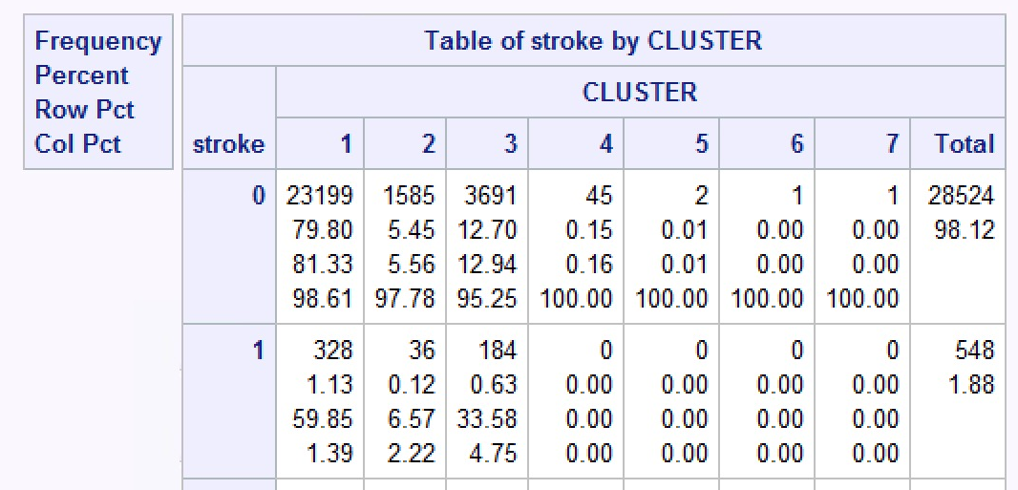
Checking Model Validity using Stroke variable
Finding: younger people in very unhealthy status have very low risk of having a stroke
May need more investigation
Notes:
We then validated our clusters using Stroke variable
We can see that cluster 1 has 1.39 percent of observations with a stroke, followed by 2.22 percent in cluster 2 and 4.75 percent in cluster 3.
For cluster 4, the percent of observations with a stroke is zero that is lowest among all four clusters
The finding that younger people with very high average glucose level and obese bmi have very low risk of having a stroke will need further investigation.

Slide 25
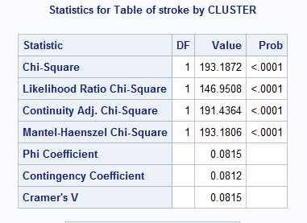
Check Model Validity using Chi-Squared Test
Chi-Squared Test of Association
P-value(<0.0001) < 0.05
Reject the null hypothesis
Confirms that the proportions of Stroke values are different in each clusters at 5% significance level
The clusters are reasonable
Notes:
To test the clusters statistically, we conducted Chi-Square Test of Association.
The p-values (<0.0001) came out to be less than 0.05, confirming that the proportions of Stroke values are different for different clusters at 5% significance level.
Hence, the clusters are found to be reasonable.

Slide 26
Interpretations
Age and Average Glucose Level have a great impact on our validation variable
Older people who struggle with their health status should be prioritized to
Create awareness
Educate on the severity of stroke
Do further medical research
Provide customized treatments
Notes:
Based on the cluster analysis, we found that age and average glucose level have a great impact on the risk of having a stroke.
It is crucial for older people to be educated on the severity of stroke and how a healthier lifestyle can lower their chance of getting a stroke. Medical professionals should perform further research specifically for older people with high glucose levels.
We should keep in mind that younger people are not entirely free from the risk of having a stroke. Younger people with high average glucose level should still be aware of the importance of a healthy lifestyle and pursue one for their own benefit.
Now, Haochen will take us to final discoveries and limitations.

Slide 27
Discoveries & Limitations

Slide 28
Discoveries
Logistic Regression
Age, smoking status, average glucose level, hypertension, and heart disease are significant
People with heart disease have a higher risk of having a stroke
Cluster Analysis
Age and Average Glucose Level play important roles
Older people with high average glucose level are more likely to get a stroke
Notes:
Although stroke is a leading cause of death in the United States, it is possible to avoid the risk of getting a stroke after the analysis.
The logistic regression model concluded that age, smoking status, average glucose level, hypertension, and heart disease have significant impact on Stroke and bmi does not. The result indicates that older people, people with hypertension or heart disease, and people with high average glucose level should be aware of their risk of having a stroke especially those with heart disease.
With the 4 clusters we summarized in cluster analysis, we were able to see that age and average glucose level play important roles in a person’s risk of having a stroke
And older people should pay more attention on their health because they are more likely to have a stroke comparing to younger people, even though younger people might not have a better health status. However, younger people with high average glucose level should still be aware of the importance of a healthy lifestyle and pursue one for their own benefit.

Slide 29
Limitations
No specific time of measurement of the average glucose level
Lead to standard inconsistency
One hour after meal is recommended
No specific amount of years for whom quitted smoking and started smoking
Never smoked and formerly smoked had similar impact on stroke
More information needed
Cluster analysis is subjective
No correct answer
Notes:
The dataset was large enough to develop complex statistical model, however, some limitations were found that may mislead the analysis result.
Firstly, the dataset did not specify when the average glucose level was tested after meal. This may lead to inconsistency because somebody may be tested one hour after the meal whereas someone else may be tested six hours after the meal. So we suggest unify the measurement time as one hour after meal.
Secondly, comparing to people who currently smokes, those that never smoked and those formerly smoked had similar odds of having a stroke. We believe a further investigation is needed in order to find why the two status have similar results.
Also, cluster analysis is very subjective and there is no correct answer when it comes to grouping and labeling observations..
Finally, gathering new predictors and data might be necessary in order to discover more accurate insights.

Slide 30

Thank you!
Stay Healthy and Safe Everybody!
Notes:
That’s for our presentations, thank you.

